Slide 1
Machine Learning & Deep Learning
Week: 7-8
Instructor: Najam Aziz

Slide 2
What is AI, ML, DL?
Artificial Intelligence - the simulation of human intelligence in machines that are programmed to think like humans and mimic their actions.
Machine learning - a “field of study that gives computers the ability to learn without being explicitly programmed.”
Dynamic-Able to modify itself, does not need human intervention
Subset of AI. All ML counts as AI but not vice versa
Deep learning - a subset of machine learning. DL is reference to deep artificial neural networks.
Deep - refers to the number of layers in a neural network.
Notes:
SymbolicAI - the rules are created through human intervention, if-then statements-oop, For example, symbolic logic – rules engines, expert systems(emulate human intelligence for complex decision making) and knowledge graphs(DB contains data in graphical format) – could all be described as AI, and none of them are machine learning.
ML/DL- learns rules as it establishes correlations between inputs and outputs

Slide 3
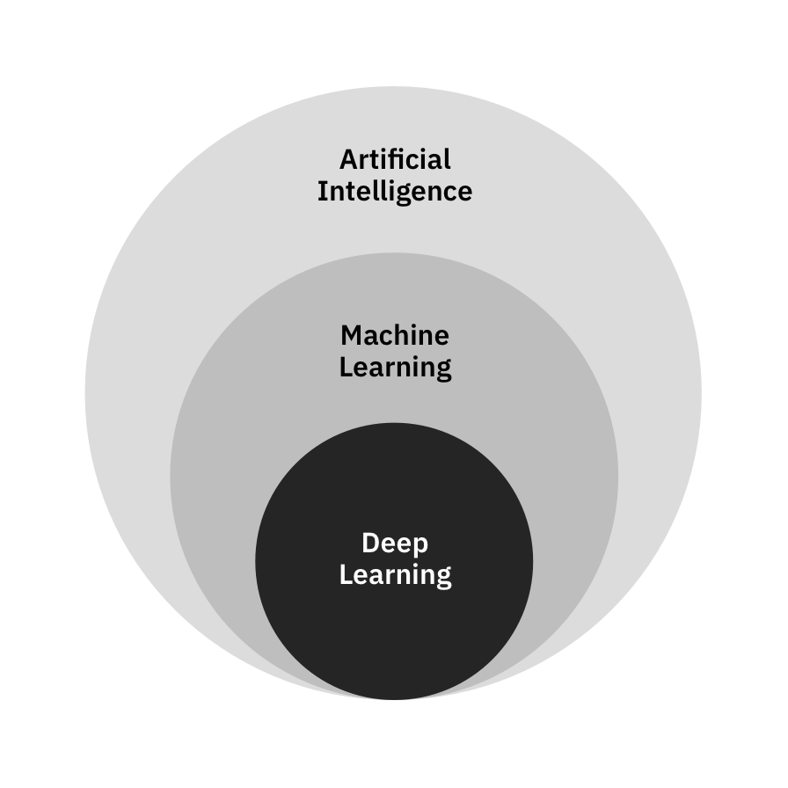
AI/ML/DL

Slide 4
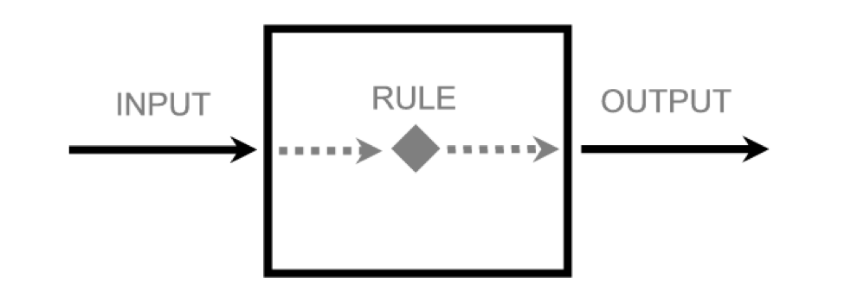
Aim/Goal
We have some input/data, want some output/desired. So, we need a Rule in between.

Slide 5
Data Science

Slide 6
What is Data?
Raw facts and Figures
Any unprocessed fact, value, text, sound or picture that is not being interpreted and analyzed.
Quantitative - Numerical
Discrete - Discrete data is a whole number (integer)
Continuous - have continuous values
Qualitative - Categorical
Non-numerical
Notes:
Quantitative: Discrete: # of people in a classroom Continous: Room Temperature. 37.5C or 37.5000001C
Qualitative: usually descriptive - brown eyes, male/female, yes/no

Slide 7
Data Type Conversion
Binning/Discretization: Transform Numerical variables to Categorical.
E.g. Age can be categorized into 0-12(Child), 13-19(Teenager), 20-65(Adult), 65+(Senior).
Binning is powerful and can be used as a filter to reduce noise or non-linearity and some algorithms such as decision trees require categorical data.
Encoding/Continuation: Transform Categorical variables into Numerical (Binary) variables.
E.g. Gender: -1 - Male, 0 - other, +1 - Female
Binary: Only 0 or 1

Slide 8
Data Exploration/Description
Summary/Descriptive statistics measurement meant to describe data.
For Numeric Variables
Mean, Median, Mode, max, min, range, quartiles/percentiles, variance, standard deviation, coefficient of determination, skewness, kurtosis
For Categorical Variables
The number of distinct counts.
Text: Frequency, inverse document frequency
Bivariate data: Linear correlation, chi-squared, the P-value based z-test, t-test, analysis of variance

Slide 9
Data Distribution - Basic Concepts of Statistics
Statistics - the discipline that concerns the collection, organization, analysis, interpretation, and presentation of data.
Variance - The average of the squared differences from the Mean.
Spread of a data set from its mean value
Magnitude of the spread
Covariance
Covariance tells us the direction in which two quantities vary with each other.
Salary has a positive covariance with respect to no. of hours worked-positive covariance
More practice-Less chance of losing
Correlation - used in feature selection to determine which feature affects the result the most.
Correlation shows us both, the direction and magnitude of how two quantities vary with each other.
Range; -1 to +1, Values between -1 and 1 denote the strength of the correlation.
Notes:
-Larger variance -the larger the distance, smaller variance - numbers in the set are closer to the mean.
You only know the magnitude here, as in how much the data is spread.

Slide 10
Understanding a Distribution
There are 3 variety of measures, required to understand a distribution:
Measure of Central tendency
Mean – or the average
Median – the value, which divides the population in two half
Mode – the most frequent value in a population
Measure of dispersion
Measures of dispersion reveal how the population is distributed around the measures of central tendency.
Range – Difference in the maximum and minimum value in the population
Quartiles – Values, which divide the population in 4 equal subsets (typically referred to as first quartile, second quartile and third quartile)
Variance: The average of the squared differences from the Mean.
Standard Deviation: is square root of variance
Measure to describe shape of curve
Skewness – Skewness is a measure of the asymmetry. Negatively skewed curve has a long left tail and vice versa.
Kurtosis – Kurtosis is a measure of the “peakedness”. Distributions with higher peaks have positive kurtosis and vice-versa
Notes:
Measures of central tendencies are measures, which help you describe a population, through a single metric. For example, if you were to compare the savings habits of people across various nations, you will compare the average Savings rate in each of these nations.
Understanding the shape of data is a crucial action. It helps to understand where the most information is lying and analyze the outliers in a given data

Slide 11
Model/Algorithm Engineering

Slide 12
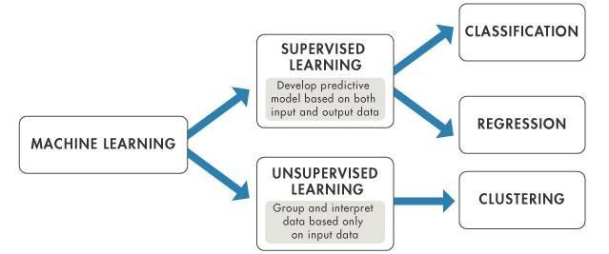
ML Problem-Model Division

Slide 13
Supervised vs Unsupervised Learning
Supervised
labeled input and output data
Examples: Linear Regression, Logistic Regression, Support Vector Machine, KNN etc.
Unsupervised
work on their own to discover the inherent structure of unlabeled data
not used as widely as supervised learning.
Examples: clustering, K-mean clustering etc
Main Difference: the use of labeled data

Slide 14
Types of Supervised Learning
Regression algorithms are used to predict the continuous values such as price, salary, age, etc.
Dependent variable is continuous in nature
finding annual sale of a company
Classification algorithms are used to predict/Classify the discrete values such as Male or Female, True or False, Spam or Not Spam, etc.
Dependent variable is discrete/categorical in nature
Example: Divide the class in age group

Slide 15
Which of the Following are Regression or Classification Task?
Predicting age of a person
Predicting nationality of a person
Predicting whether stock price of a company will increase tomorrow
Predict whether a customer is eligible for a loan
Price of Car
Predict if Covid patient Survive?
Notes:
Predicting age of a person (because it is a real value,
predicting nationality is categorical,
whether stock price will increase is discrete-yes/no answer

Slide 16
Types of Regression
Univariate Linear Regression
variables: independent =1 and dependent =1
Relationship Nature: Linear
Multiple Regression
variables: independent >1 and dependent =1
Relationship Nature: Linear/Non Linear
Multivariate Regression
variables: independent >1 and dependent >1
Relationship Nature: Linear/Non-Linear
Polynomial Regression
the power of the independent variable is more than 1.
Relationship Nature: Non-Linear
Y = a + bX^2
The best fit line is not a straight line, rather a curve that fits into the data points.

Slide 17
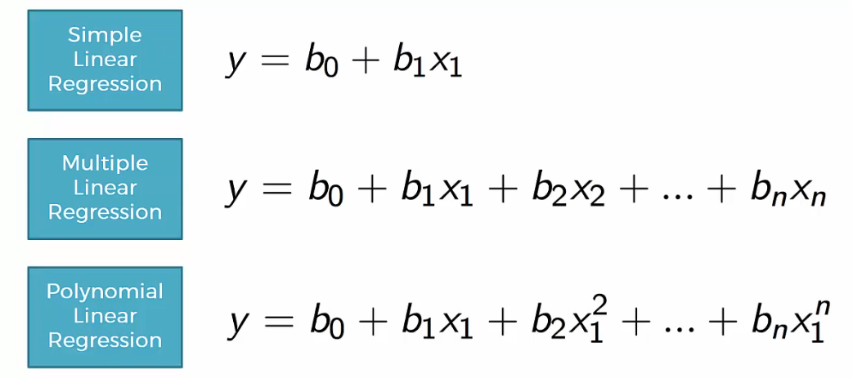
Regression

Slide 18
Linear and Logistic Regression
Linear regression is used to predict the continuous dependent variable using a given set of independent variables.
Logistic regression is usually used with binary response variables ( 0 or 1 ), the predictors can be continuous or discrete.
Used for Classification problem
example: Time spend on website and click on ads

Slide 19
Classification Models/Algorithms

Slide 20
Classification Algorithms
SVM
KNN
Naïve Bayes
Decision Tree

